Slide 1

MALIGNANT COMMENTS CLASSIFIER
- Anchal Awasthi

Slide 2
Table Of Contents :-
1. Introduction
1.1 Problem Statement and understanding
2. EDA steps and Visualization
3. Steps and assumptions used to complete the project
3.1 Data Preprocessing Done
3.2 Set of assumptions related to the problem under consideration
4. Model Training
5. Trained Model
6. Conclusion

Slide 3
Introduction
The proliferation of social media enables people to express their opinions widely online. However, at the same time, this has resulted in the emergence of conflict and hate, making online environments uninviting for users. Although researchers have found that hate is a problem across multiple platforms, there is a lack of models for online hate detection.
Online hate, described as abusive language, aggression, cyberbullying, hatefulness and many others has been identified as a major threat on online social media platforms. Social media platforms are the most prominent grounds for such toxic behaviour.
Our goal is to build a prototype of online hate and abuse comment classifier which can used to classify hate and offensive comments so that it can be controlled and restricted from spreading hatred and cyberbullying.

Slide 4
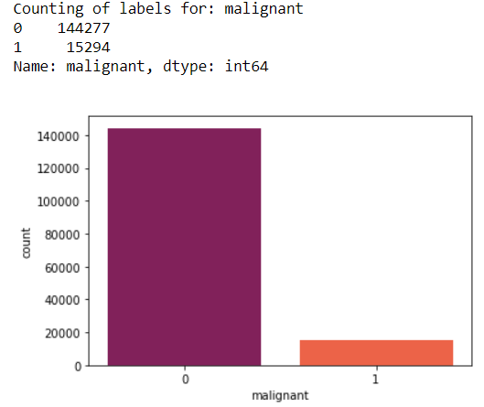
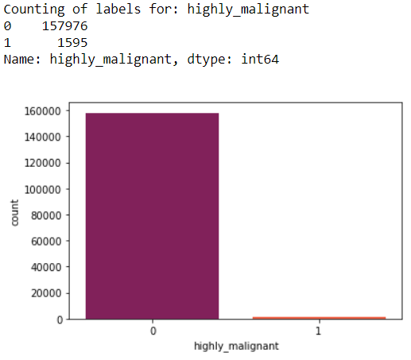
EDA & Vizualization

Slide 5
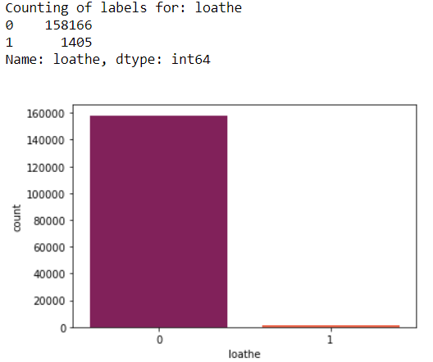
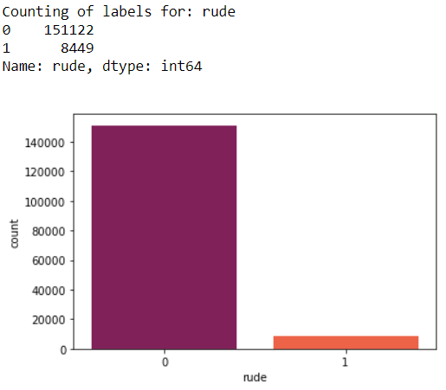

Slide 6
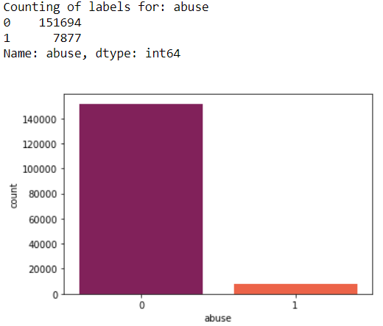
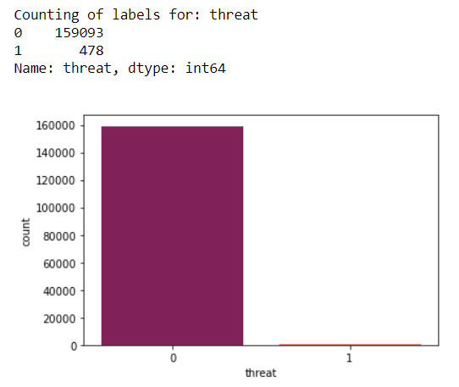

Slide 7
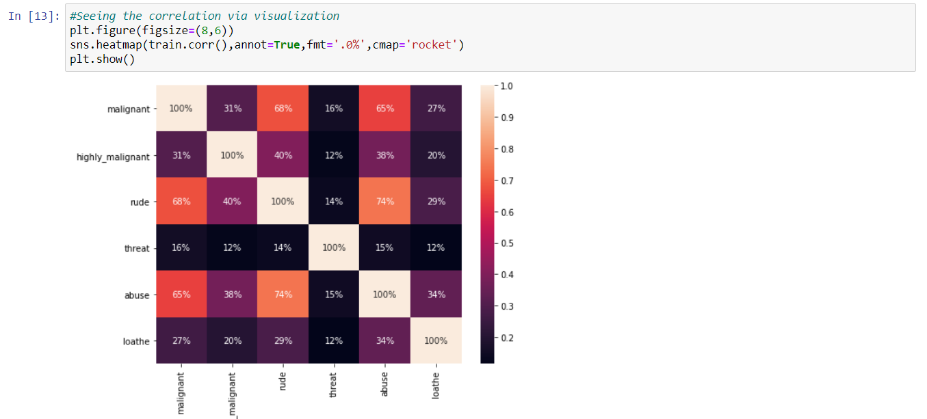

Slide 8
Data
The data set includes:
Malignant: It is the Label column, which includes values 0 and 1, denoting if the comment is malignant or not.
Highly Malignant: It denotes comments that are highly malignant and hurtful.
Rude: It denotes comments that are very rude and offensive.
Threat: It contains indication of the comments that are giving any threat to someone.
Abuse: It is for comments that are abusive in nature.
Loathe: It describes the comments which are hateful and loathing in nature.
ID: It includes unique Ids associated with each comment text given.
Comment text: This column contains the comments extracted from various social media platforms.

Slide 9
Data Description
Project contain train and test dataset.
In train data set there are 159,571 rows and 8 columns.
In test data set it is like 153,164 rows and 2 columns.
There are no null values in the dataset
Most of the data are numeric in nature which are binary.
Comments is object in nature and consist of text.
Overall memory usage for train and test is around 15MB.

Slide 10
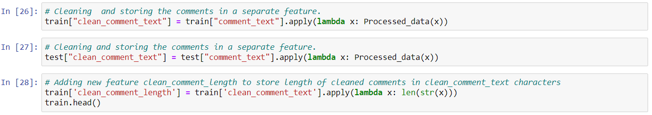
Data Pre processing
As there are no null values in the dataset, but as the comment column in text format hence it requires pre processing.

Slide 11
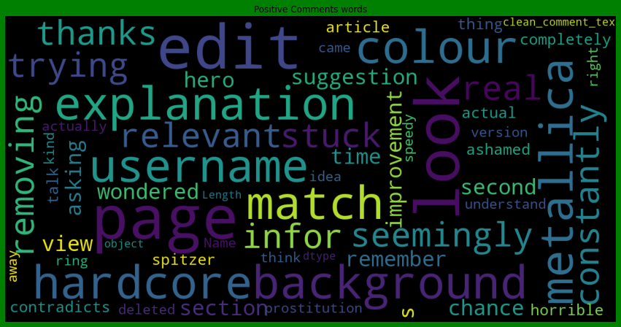
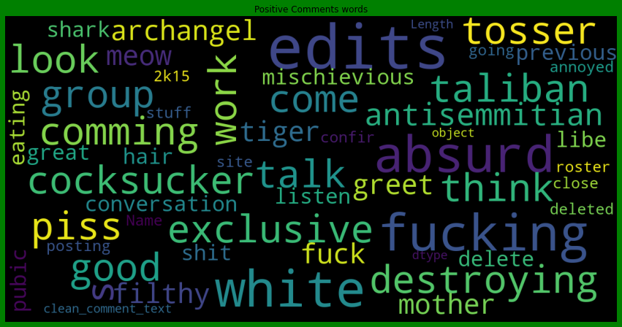

Slide 12
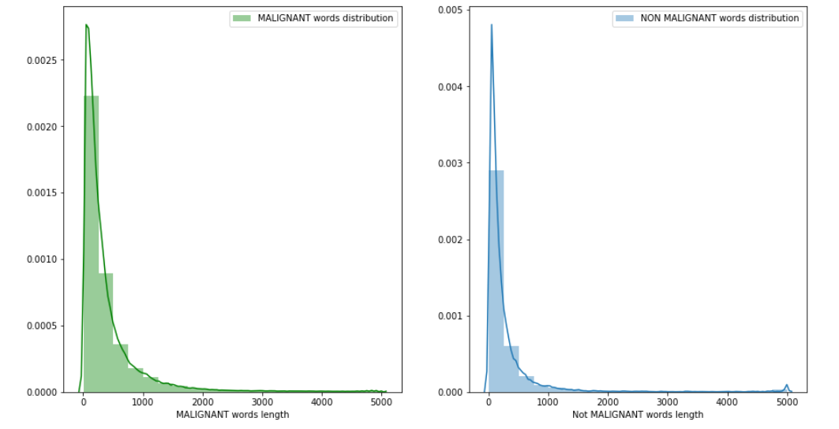

Slide 13
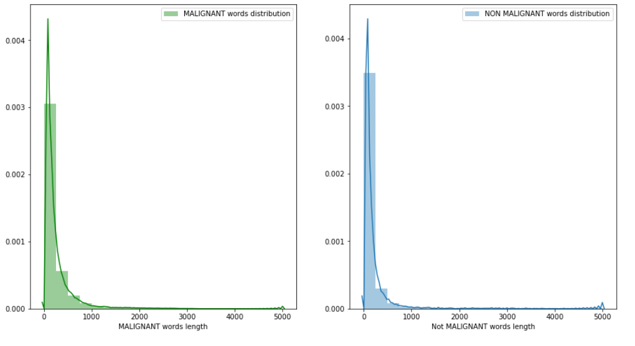

Slide 14
Trained Model
The model building process involves setting up ways of collecting data, understanding and paying attention to what is important in the data to answer the questions you are asking, finding a statistical, mathematical or a simulation model to gain understanding and make predictions.
Evaluation Matrices:
Accuracy - it determines how often a model predicts default and non default correctly.
Precision-it calculates whenever our models predicts it is default how often it is correct.
Recall- Recall regulate the actual default that the model is actually predict.
Precision Recall Curve - PRC will display the tradeoff between Precision and Recall threshold.
F1 score - the F1-score, is a measure of a model's accuracy on a dataset. It is used to evaluate binary classification systems, which classify examples into 'positive' or 'negative'.
Cross Validations:
K Fold cross validations , K = 10

Slide 15
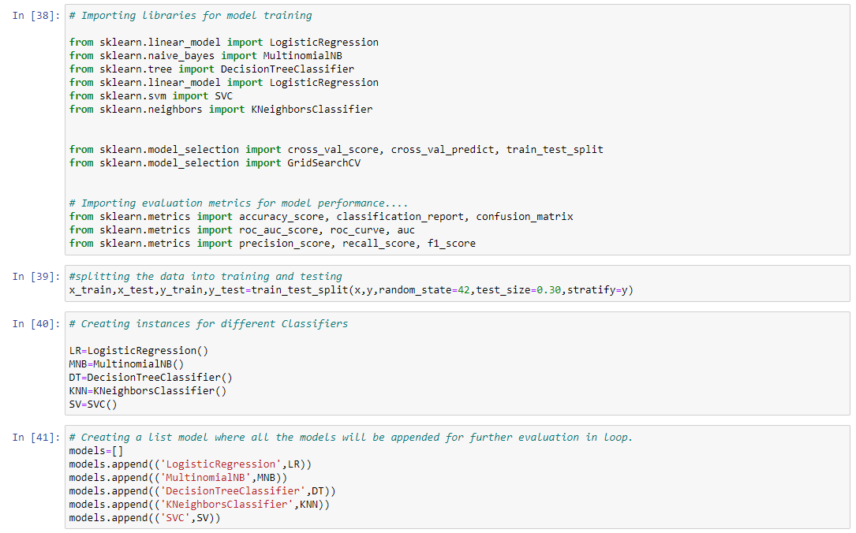

Slide 16
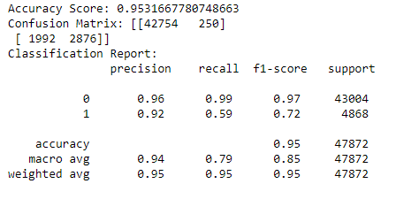
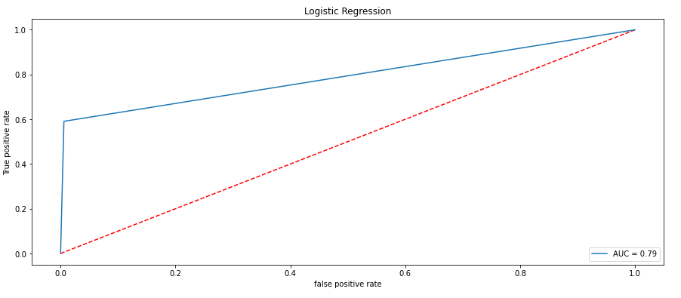
Trained Model

Slide 17
Conclusions
•We have got Logistic Regression as best model since it’s giving us good result and other metrics are also satisfactory.
•Using Logistic Regression as our final algorithm we have predicted the values for test dataset and it’s also working well and is able to differentiate/predict negative comments and non-negative (good) comments.
•From displaying the data, it seems there is lot of special characters present in the data. So, it is better to proceed by filter it out.
•As the above data is in text, so presence of special characters and stopwords is always there.
•After proper cleaning and processing, decision tree classifier gives the highest accuracy as well as ROC Score.

